Slide 1



Volunteering Circle of Life
Understanding the life cycle of volunteers to become an organisation of choice!
Notes:
HY
The volunteer lifecycle is a common way of thinking about the stages of volunteer management .
When we talk about volunteer management, the best practices don’t just apply to the volunteering experience.
Good volunteer management entails following an optimized process throughout the volunteer lifecycle, which consists of the following stages:
Needs analysis and infrastructure support
Recruitment
Application and screening
Orientation/training
Assignment and execution
Retention

Slide 2
Plan and design
Review, plan and design your volunteer program
Determine your priorities – which programs are most important to commence first?
By conducting a needs analysis you will identify skills & knowledge required to deliver successful programs
Create new and innovative ways to carry out volunteer programs
Digital Volunteering Opportunities
Projects for students, people with disabilities, newly arrived migrants
Notes:
Needs analysis
The very first step of developing a volunteer program is writing out a plan describing your needs. This analysis lays the foundation for all the other tasks that follow. Here are a few questions you need to answer when doing a needs analysis:
What functions/areas do you need volunteers for?
What are the specific tasks that volunteers would work on?
For what duration would you need the volunteers?
What skills are required for these tasks?
Who would coordinate the volunteer program?
What kind of benefits are you planning to offer to your volunteers to hook them?
How can volunteers connect and support your program ? – can some work remotely using digital tools?
Are their short term project which can give students a taste of volunteering?
Can people with a disability participate?
Is there a role for newly arrived migrants ?

Slide 3

Organisational Infrastructure
Volunteer Policy
Systems to manage and record volunteer
information ( database)
Policies and Procedures
Risk management
Volunteer Handbook
Notes:
Best practice volunteer management is guided by legislation , organisational policies and procedures, risk management and the relationships you build with your volunteers.
Update existing Policies and Procedures Manuals and volunteer packs to comply with National Standards for Volunteer Involvement!
Review your Risk Register listing all possible risks to volunteers when they recommence their roles

Slide 4
Which policies and Procedures should you have:
Volunteer Policy (rationale, rights and responsibilities)
Recruitment (including Role descriptions, selection process, diversity and discrimination
Orientation and Onboaarding
Support and Supervision
Grievance procedures and disciplinary policy
Exit procedures
Sexual harassment
Confidentiality
Volunteer reimbursements
Volunteer Insurance
Health and safety
Notes:
Ideally you should have the following Policies with procedures in place prior to advertising or engaging volunteers.
Volunteer Policy (rationale, Volunteer rights and responsibilities)
Recruitment (including Volunteer Role Descriptions, selection process, diversity and discrimination
Orientation and Onboarding
Support and Supervision
Grievance procedures and disciplinary policy
Exit procedures
Sexual harassment
Confidentiality
Volunteer reimbursements
Volunteer Insurance
Health and safety

Slide 5

Which documents should you have?
Volunteer agreement
Rights and responsibilities guidebook
Volunteer Role description
Application/registration form
Interview record sheet
Application progress sheet
Onboarding checklist
Standard appointment letter/standard rejection letter
Volunteer annual review record
Volunteer resignation form
Volunteer exit thank you letter
Volunteer exit survey
Notes:
Documentation required prior to engaging volunteers is :
Volunteer role descriptions ( Justice Connect )
Volunteer agreement ( Justice Connect – sample)
Handbook / guide with Rights and responsibilities
principles of volunteering
Code of Conduct
Application/registration form
Interview method & record sheet
Application progress sheet
Induction checklist
Copy of the Organisations Purpose / Role – how the volunteer roles support this purpose.
Copy of annual report
Copy of Calendar of important dates to your organisation or of National Significance e.g.: NVW
Training schedule: individual or on the job
Options for First Aid / Mental Health First Aid training
Standard appointment letter/standard rejection letter
Contact person details in case of an emergency
Contact details of senior staff / supervisor
Volunteer annual review record
Volunteer resignation form
Volunteer exit thank you letter
Volunteer exit survey

Slide 6
Volunteer Role Descriptions
Following analysis of your volunteer program
Review, update or create new Volunteer Role Descriptions to link with your purpose, ensuring your Volunteer Managed Programs and organisation are operating in a safe manner.
Include your organisations Vision, Values and Mission
All volunteers need to clearly understand the purpose of their role, hence the role description needs to reflect this.
List legislative checks required
Notes:
Create meaningful volunteer role description to ensure everyone has a good understanding through out the process.
Including:
Role title, approx. number of hours required , location , tenure, supervision, volunteer duties and responsibilities, skills/qualifications required/ Background checks.
Your organisations Vision, Values and Mission ( purpose of the organisation – links to volunteer program)
All volunteers to be clearly understand the purpose for their role – linked to purpose of organisation
Does the volunteer have a medical clearance and plan to return to community activities .
Having said all of this, please be adaptable, flexible with your VRD’s. If you find the right person to volunteer but they don’t have qualifications, adjust the role description to fit the tasks the volunteer will be doing.
E.g., asking for drivers license when volunteer is doing admin and wont need a to drive anywhere!
Make the paperwork clear, & easy to read, use simple wording, dot points, clear fonts, lots of white paper.
DISCUSSION IF TIME ALLOWS

Slide 7
Advertise and Recruit
Create new volunteer role descriptions – flexible and meaningful opportunities to engage a new range of volunteers.
Identify mediums you wish to advertise through
Identify how to conduct interviews
Put a closing date on recruitment
Ensure there are policies in place for potential volunteers over all ages
Check age range with Insurance companies
Notes:
MD
Decide where and how you are going to advertise for your volunteers. What mediums will you use? Traditional newspapers, local radio, maybe Facebook , Seek or even online. Have you thought of using a digital platform
Create a catchy title
What is your point of difference?
Decide who will respond to phone inquiries – nothing worse than reception answers the phone and does not know about the role, interview process etc.!
Some organisations offer an information session to allow potential volunteers to attend, ask questions and learn more prior to applying for the role.
This can assist with expectations about the type of volunteer required, familirises the volunteers with what the organisation does.
The next step in the volunteer lifecycle is planning the recruitment process. Basically, this is where you define how you plan to recruit volunteers who have the skills and time to help you.
Here’s what you have to lay out at this stage:
How do you want to portray your organization’s image? Volunteers are only going to give their time to organizations they feel are worthwhile.
Develop the messaging for the recruitment process. This includes your appeals, the hook, requirements/role, etc.
What channels will you be using to reach your target audience?

Slide 8
Interview and Screen
Identify options for interviews:
Screening
Working with Children’s
Police & Reference Checks
COVID Certificate
Other checks required
Facetime
Face to Face
Zoom
Microsoft Teams
Telephone
Notes:
Here’s what you need to plan for:
The design and type of application. E.g. Will it be an online form or a physical copy?
What kind of questions will the application include?
Are there any additional documents that you’ll ask for? For instance, a government id card.
What factors would you use to filter out suitable applicants and match them with the right roles?
Interviews:
Develop a list of questions so that each interview has a consistent format, focusing on the skills required to aid clarity and expectations for both parties.
Diversity of volunteers:
We encourage you to actively engage a mix of ages, backgrounds, abilities to reflect your community.
Create a safe and inviting space for the interviews
Identify skills, experience and qualifications to match the applicants to the task.
Provide an opportunity to learn about the applicants motivation, suitability and prospects.
Determine the screening requirement for each volunteer role is guided by legislation, organisational policy and risk assessment based on the role.
Follow up on referees, conduct necessary checks

Slide 9
Onboarding
Orientate volunteers to your location/ environment
Onboard volunteers so they have a good understanding of mission, vision, values and purpose of the organisation and their role
Is there training online, in person, mentorship…
Volunteer Role Description
Volunteer Agreement
COVID Compliance
Notes:
Onboarding is the new word for Induction!!
Create an onboarding check list / Orientation guide
Ensure the orientation and inductions is engaging and appropriate for the role
Some organisation lInk the volunteer with a buddy to support them
Provide a Volunteer Information pack
Risk Management – OHS policy ensure you conduct a risk assessment of all volunteer roles
Volunteer insurance
Ensure that your volunteer records ad data base are all up to date in case further information required by the insurer to support a volunteers claim
Volunteer emergency contact person ( update yearly)
Provide tour of premises and provide opportunity for volunteers to mix with each other for support

Slide 10
Supervise and Support
Provide equipment needed to do the tasks
Have an open door policy, where possible
Encourage and welcome feedback from volunteers
Regular communications e.g. – team meetings, zoom sessions and newsletters, weekly emails
Have staff and volunteers work together to understand the contributions each other make
Risk management – Occupational Health & Safety
Keep records and contract tracing is required. Keep distance and stay home if unwell.
Notes:
Providing ongoing training and support to volunteers is vital.
After the training, your volunteers will be more equipped to carry out their assigned tasks.
There’s not a lot that you need to plan for at this stage except for:
Developing a way to supervise the volunteers at work.
Assigning a point person for each team to who they can reach out in case of any challenges.
Developing a way to give and collect feedback from volunteers to make their experience better.
Providing them with the right resources to make volunteers more productive and efficient.
Where possible have an open door policy to allow volunteers to connect regularly with the supervisor or manager.

Slide 11
Reward and Recognition
Thank volunteers regularly
Celebrate the achievements of your volunteers and volunteer programs
Participate in International Volunteers Day
Participate in National Volunteer Week
Participate in National Student Volunteer Week
Thank you cards, morning teas
Notes:
The final stage of the volunteer lifecycle is retaining them. This is a crucial step in the lifecycle if you wish to build a solid, reliable supporter base. This is where you strategize ways to make sure your volunteers stick to your organization. Some of these strategies include:
Recognising volunteers regularly for the effort.
Conveying their impact to keep them motivated.
Establishing a mutually beneficial relationship with volunteers to ensure they get what they wished for from the opportunity.
Acknowledging volunteers in your Organisation's annual report , collate the number of hours provided by volunteers – a magnificent achievement!
Make calls or ttexts to simply check up on volunteers and how they have been doing in general.

Slide 12
Evaluation
Evaluate and review your volunteer program
Review and revise your risk management plan
Update in accordance with all legislation including COVID Safe practices
Review and adjust your existing policies and procedures
Notes:
Evaluate your volunteer program annually including collecting feedback from volunteers who left during the year. Supporters involved in your past volunteering programs are the best source of the shortcomings in the past.
Whether they’re volunteering with you for the current program or not, reach out to them and ask them if:
The training you provided was adequate.
Was there anything missing from the orientation or training that you should have included?
Is there anything you should have done differently?
Were there any extra resources that you should have provided?
You may get a large number of suggestions from this survey. But you can narrow them down to the ones that appear most commonly and start by improving them first.
Review and revise your risk management plan
Update in accordance with all legislation including COVID Safe practices
Review and adjust your existing policies and procedures
Use this review to collate learnings prior to beginning your next recruitment drive and volunteer engagement.

Slide 13
Plan &
Design
Onboarding
Support &
Supervise
Recognition
& Reward
Evaluate
Advertise &
Recruit
Interview &
Screen
Recruiting volunteers
Volunteering
Circle of Life
Notes:
Life Cycle of Volunteers
Remember :
The more volunteers you retain, the stronger base of support you build, and the more you push your mission forward.
Retention efforts typically start from the point a volunteer starts executing their tasks and extends way beyond the end of the campaign.
Showing your gratitude should be something you do on a regular basis to earn their loyalty. Building deeper relationships with your volunteers, of course, begins with thanking them, giving recognition in front of peers and can also include social gatherings, birthday recognition, knowing family names and acknowledging important moments in their lives.
Focus on training and offering additional skill-development opportunities and leadership roles to let them know they are valued.
Volunteer grants are a highly effective way to help volunteers feel that they’ve made a positive impact on your work ( available through Australian Government )
Expressing your gratitude, investing in their skills, and finding ways to boost their impact are all great ways to build lifelong relationships with your volunteers.

Slide 14

Tools & Resources
Use a volunteer program status snapshot checklist
https://www.volunteeringvictoria.org.au/wp-content/uploads/2020/06/Volunteering-Program-Status-Snapshot.pdf
Individual volunteer program assessment checklist
https://www.volunteeringaustralia.org/wp-content/files_mf/1377052757VaGuidetotrainingvolunteerspartB.pdf
Justice Connect:
www.justiceconnect.org.au
Notes:
Tools to assist you include following websites
Volunteering Victoria
Volunteering Australia
Justice Connect

Slide 15

Q & A
Break

Slide 16

DIVERSITY & INCLUSIVITY Matter
You are delivering services to a diverse community.
Your service users have the right to see themselves represented in the services they access.
Recruiting a diverse workforce (paid and volunteer) promotes the safe participation of marginalised groups in your community.
Notes:
Recruiting a diverse workforce (paid and volunteer) promotes the safe participation of marginalised groups in your community.

Slide 17

Volunteering – Diversity & inclusivity
Recruiting
& On-boarding
Volunteers from
CALD communities
Notes:
Build relationships with your local CALD communities.
Network with CALD organisations/ CALD supporting organisations.
Collaborate with CALD community to develop a CALD volunteering strategy.
Face to Face communication most effective in building trust.
CALD representation is your BEST recruitment strategy.
Advertise in CALD spaces.
Streamline/ simplify recruitment processes (including background checks).
Be aware of your use of language.
Ensure workplace culture is one that embraces and is inclusive of diversity (policies and practices).
Don’t make assumptions about competencies/ cultural practices.
Be flexible in your management and support of CALD volunteers.

Slide 18

Volunteering – Diversity & inclusivity
Recruiting and On-boarding
Volunteers who identify as having a Disability
Notes:
What is a disability ?
United Nations Convention on Rights of Persons with Disabilities signed in 2006
…..”in interaction with various barriers, may hinder their full and effective participation in society on an equal basis with others”
A workplace adjustment is a CHANGE to a work process, practice, procedure or environment that ENABLES a volunteer with a disability to perform the essential requirements of their role.

Slide 19

Volunteering-
Diversity & inclusivity
  Create a Diversity & Inclusivity Action plan in collaboration with volunteers with lived experience.
  Consider where you can be flexible with role positions.
  Encourage involvement of Support workers-consider training be provided to volunteer, support worker and staff members
  Don't make assumptions about abilities.
  Provide variety in roles.
  Use a blend of advertising media and consider whether information is accessible via advertising platforms.
Notes:
Create a Diversity & Inclusivity plan in collaboration with volunteers with lived experience.
Consider where you can be flexible with role positions.
Encourage involvement of Support workers-consider training to be provided to both volunteer and support worker.
Don't make assumptions about abilities.
Provided variety in roles.
Use a blend of advertising media and consider whether information is accessible via advertising platforms.

Slide 20

Best practice approaches
Consider:
Do we indicate that we are welcoming of people from diverse backgrounds and abilities. It is important not to be tokenistic but including an affirmative or welcoming statement in your position description will likely welcome a greater pool of talent. Language choice is critical.
Promote your volunteer roles through disability or migrant support services to reach a wider pool of people.
Using a blend of advertising media is important to ensure that all people an access your volunteer opportunities.
Notes:
Best practice as recommended by Volunteering Victoria is to clearly and routinely scope volunteer roles and develop Volunteer Role Descriptions for your volunteers. Over time these Role Descriptions can become standardised and contain requirements that are unnecessary which create barriers for people with disability.
- Does the volunteer need a drivers license to perform the role?
- Do they need to do heavy lifting?
- While a clear role scope is preferable, are you able to be flexible with your requirements and is this noted in the position description?
- Can the role be divided or shared by two volunteers?
- Do you indicate that you are welcoming of people with disability, or have a migrant background It is important not to be tokenistic but including an affirmative or welcoming statement in your position description will likely welcome a greater pool of talent. Language choice is critical.
- Consider promoting your volunteer roles through disability or migrant services or to reach a wider pool of people.
- If you recruit volunteers through your website, is it clear and accessible? Is the font and text readable for assertive technology and software? Is the pathway to volunteer opportunities prominent?
2. Volunteers deserve a valued role and this depends on the expectations and aspirations of the individual. For example, some people (including those with a disability) enjoy basic
repetitive tasks while others prefer lots of contact with people. Though your organisation may require a specific outcome from a volunteer, it may be possible to negotiate the fine details once someone has been recruited and their personal preferences have been determined.
3. Using a blend of advertising media is important to ensure that people with a disability can access your volunteer opportunity. Some people with a disability will be dissuaded from applying if they cannot access the recruitment process due to a lack of alternative format, for example, large print, easy English, audio/radio and online. It is acceptable to specify that positions are suitable for a volunteer with support needs, with a disability or with special needs.

Slide 21
Guiding Principles
Australian Network on Disability has 3 guiding principles which may be of assistance as a good practice when you interview or engage with a person with a disability .
Never make any assumptions
Always ask the person
A person’s disability and their experience of disability , is as unique as their fingerprint.
Notes:
Australian Network on Disability has 3 guiding principles which may be of assistance as a good practice when you interview or engage with a person with a disability
Never make any assumptions
Always ask the person
A person’s disability and their experience of disability , is as unique as their fingerprint.

Slide 22
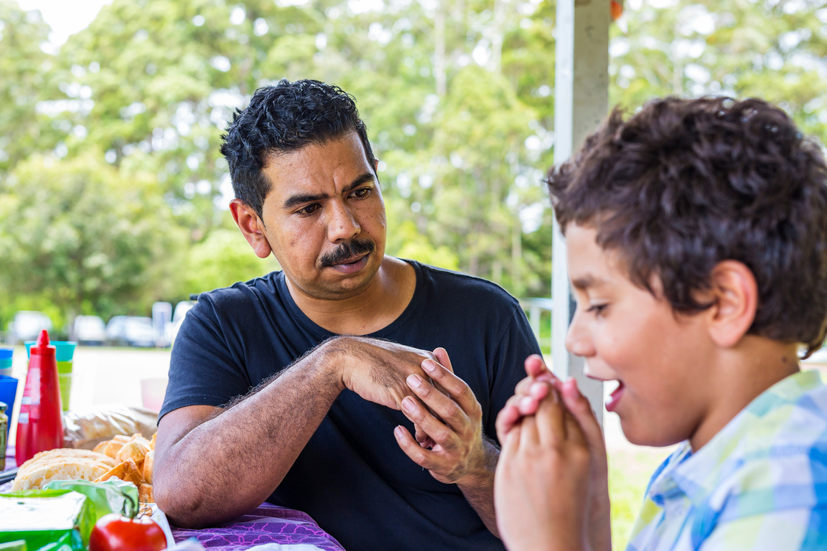
Community Giving
Recruiting
and
On-boarding
First Nations
Volunteers
Notes:
Important to recognise that whilst First Nations communities are reported to participate less frequently in formal volunteering they are still actively involved in informal volunteering within their communities.
Its not that First Nations do not volunteer but that different language is used and it tends to stay within the community and be more informal.

Slide 23
First Nations
  Know your First Nations Communities.
  Build trusting relationships.
  Collaborate with First Nations Communities.
  Engage with First Nations volunteer organisations.
  Don't make assumptions about capability of cultural practice.
  Take active steps to engage all staff in cultural safety training specific to the first Nations communities you interact with.
Notes:
Who are your local First Nation Communities?
Introduce yourself and your organisation, see if you can be invited along for a yarn. Let them lead the interactions.
Collaborate, listen and learn
Work on your cultural understanding
Form partnerships and working relationships with First Nation VIOs, work alongside them.
Remember that providing onboarding documentation can be challenging.

Slide 24

Breaking down the barriers to volunteering
Group activity
Small group discussion regarding what are the common barriers to engaging volunteers?

Slide 25
You are invited to register to attend quarterly leadership meetings
- run by volunteering loddon mallee (VLM) project vlm@bgovolunteers.org.au

