Slide 1



Dynamic Committees –
Leading your Community
Notes:
HY
I acknowledge the traditional owners of the land on which we meet today and pay my respect to elders, past, present and emerging.
I acknowledge their living culture and unique role in our communities across Central Victoria.
Happy National Volunteer Week.:
This week we celebrate volunteering across Australia and give thanks for the valuable and unique contribution of volunteers to our lives.
Its important to stop and thank volunteers for sharing their time, talents and energy to support a wide range of vital services, community activities, and vulnerable people living in our community.
Purpose of the workshop – guidance to good governance
Volunteering enables us to reconnect to others in the community through meaningful participation to support a cause we are passionate about, engage in healthy activities through recreation and sporting activities and react spontaneously through random acts of kindness by being neighbourly and caring for our community.
This years theme is Change Makers ( change maker notes!)

Slide 2
Dynamic Committees –
Leading your Community
Notes:
HY
I acknowledge the traditional owners of the land on which we meet today and pay my respect to elders, past, present and emerging.
I acknowledge their living culture and unique role in our communities across Central Victoria.
Happy National Volunteer Week.:
This week we celebrate volunteering across Australia and give thanks for the valuable and unique contribution of volunteers to our lives.
Its important to stop and thank volunteers for sharing their time, talents and energy to support a wide range of vital services, community activities, and vulnerable people living in our community.
Purpose of the workshop – guidance to good governance
Volunteering enables us to reconnect to others in the community through meaningful participation to support a cause we are passionate about, engage in healthy activities through recreation and sporting activities and react spontaneously through random acts of kindness by being neighbourly and caring for our community.
This years theme is Change Makers ( change maker notes!)

Slide 3

Values
Mission
Vision
Importance of Purpose
Notes:
HY Purpose for todays’ workshop:
The vision and mission statements provide a purpose and objective to organizations and instils in Board members, executives, staff and volunteers with a sense of belonging, of being on the same pathway. Vision and mission statements are the personification of organizational identity and carry the organizations dogma and motto.
A vision and mission statement defines the way in which the organization operates. Since they define the reason for existence of the organization, they are indicators of the direction in which the organization must move to actualize the goals in the vision and mission statements.
The vision and mission statements serve as central points for individuals to identify themselves with the organization. It gives them a sense of direction.
The vision and mission statements help to translate the objectives of the organization into work structures and to assign tasks to the people that are responsible for actualizing.
With a mission to enhance the liveability of a region, volunteering is an important aspect of community life. Good quality, committed leadership is required to build a liveable community which in turn, fosters community engagement leading to the building of strong relationships, pride and resilience.
Good Governance is clarified by good leadership, to safeguard the organisations interests, ensure accountability and long-term sustainability. Knowing your purpose and thinking strategically, provides structure and rigor to organisational decision making.
All committee members have a responsibility to be active participants in the strategic planning of the group, to understand and appreciate the purpose of the committee, which is to develop and set positive, achievable goals, monitor the progress towards achievement of goals, evaluate the progress of any projects, and to agree to adapt or change plans which improve the development of the community group or organisation.
Active participation is key to good planning and will inform and equip committee member to undertake their governance role.

Slide 4
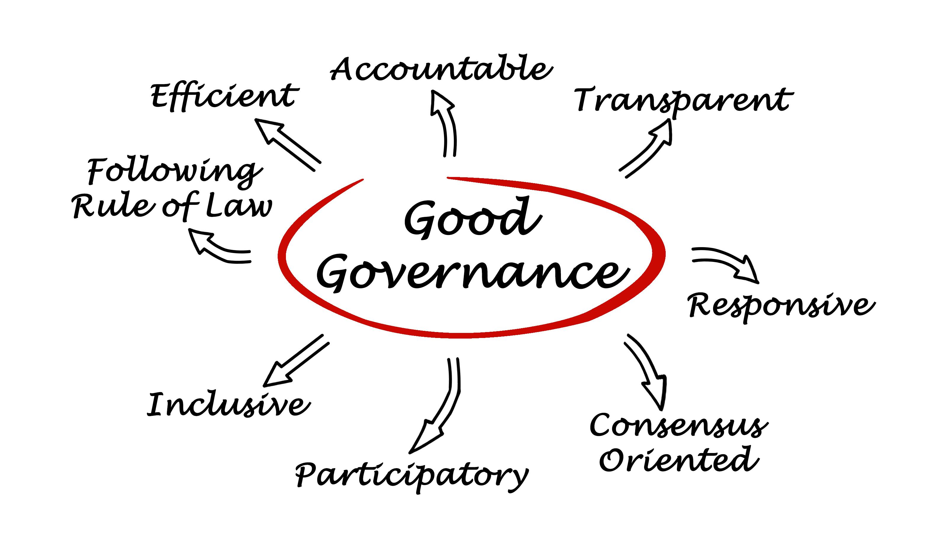

Notes:
Governance is ensuring respect for human rights and the rule of law; strengthening democracy; promoting transparency and capacity in public administration.“
8 principles of good governance include:
Being Accountable, transparent, responsive, consensus orientated, participatory, inclusive, follow Rule of law, efficient.
Good governance is an important aspect of local governments, Boards and committees. It aims to promote more relationships between government and empowers citizens.
Good governance in local government aims to increase civil engagement with more members of the community in order to get the best options that serves the people
Participation - People should be able to voice their own opinions through legitimate immediate organisations or representatives.
Rule of Law - Legal framework should be enforced impartially, especially on human right laws.
Consensus Oriented - Mediates differing interests to meet the broad consensus on the best interests of a community.

Slide 5
Risk Management
All committee members must take a responsible approach to decision making, problem solving and adopt good risk management principles
Is a procedure developed to avoid or minimise any negative consequences and reduce potential legal liability
Seeks to address potential problem areas before they occur and create a safer environment
Is a process to test the effectiveness of measures to prevent events happening that may result in negative outcomes?
Notes:
HY All committees have a responsibility to manage any risk associated with their committee and organisation.
As a committee member you must take a responsible approach to decision making and problem solving. You need to adopt good risk management principles.
Risk management should become a part of a group or organisation’s culture, its philosophy, practices and processes.
Risk Management:
Is a procedure to avoid and minimise negative consequences and reduce potential legal liability
seeks to address potential problem areas before they occur and create a safer environment
Is a process to test the effectiveness of measures to prevent events happening that may result in negative outcomes?
Risk reduction involves taking all reasonable, practicable steps to reduce identified risk and minimise loss, injury or harm.

Slide 6
Committee members Obligations
Duty to act in good faith & for proper purpose
Duty to act with care, skill and diligence
Duty not to dishonestly use position or information
Duty to avoid conflict of interest
Laws that cover committees are ‘common law’ and legislation - depending on the type of organisation.
Notes:
HY As a committee member, you have a number of legal obligations or duties that you must understand and comply with.
Committee or Board members who breach these duties may be held personally liable ( legally responsible ) for their breach .
The organisations’ members elect members to the committee in good faith that they will undertake their role within legal boundaries and not break the trust of the members.
Committee members must act in the best interest of their members at all times.
People may be appointed to a committee because they possess specialised knowledge or skills, which will be of benefit to the organisation e.g.: Accountant takes on the role of being the treasurer for community group.
The duty to be diligent requires committee members to be thorough in their decision making, keep up to date on developments in the organisation business and ask for more information if necessary.
Committee members are in a position of power and trust and have access to private and confidential information.
It is important that this information is not used to gain an advantage for yourself!

Slide 7
Be diligent about the financial viability:
    how much it takes to operate the organisation
    where the income comes from?
    what fundraising is undertaken?
    who is responsible for handling monies and payment of accounts?
    what each report means when they are presented at meetings?
    that acquittals are being reported accurately and timely?
    Ask questions!
If you have any concerns, ask for professional advice and don’t approve further financial transactions until satisfied.
Notes:
HY A committee member learns:
how much it takes to operate the organisation
where the income comes from
what fundraising is undertaken
who is responsible for handling monies and payment of accounts
what each report means when they are presented at meetings
that acquittals are being reported accurately and timely
To ask questions!
If you have any concerns, ask for professional advice and don’t approve further financial transactions until satisfied.

Slide 8
Conflict of
Interest
If a decision is likely to benefit one committee member or a person close to the committee member, that member is no longer in a position to make an impartial decision as there is a clear conflict of interest.
If a conflict has been identified, it must be disclosed and from that moment is disclosed, therefore the committee member is no longer invited to exercise judgement or comment on how it should be resolved.
Having clear guidelines in place around potential conflicts and ethical standards sends a message to all who have dealings with the committee that it is committed to upholding certain standards and is transparent about what it believes is appropriate behaviour.
Notes:
MD Every decision of the committee must be impartial and in the best interest of the organisation.
If a decision is likely to benefit one committee member or a person close to the committee member, that member is no longer in a position to make an impartial decision as there is a clear conflict of interest.
The principles of managing conflict of interest are clear and every committee should have a policy in their committee manuals.
If a conflict has been identified, it must be disclosed and from that moment of disclosure, the committee member is no longer invited to exercise judgement or comment on how it should be resolved.
The committee member should be excluded from any further discussion and is not permitted to vote
This conflict must be noted in the minutes.
Having clear guidelines in place around potential conflicts and ethical standards sends a message to all who have dealings with the committee that it is committed to upholding operating standards and is transparent about what it believes is appropriate behaviour.

Slide 9
DEALING
WITH
DIFFICULT SITUTIONS
BE CLEAR: Don’t assume others know what you’re thinking
DON’T ASSIGN BLAME
LISTEN & HEAR – also to what isn’t being said
WATCH THE BODY LANGUAGE – what is it telling you
DON’T STORE UP FRUSTRATIONS
Work out what you really need versus
what you want and
what you are willing to give up.
ACCEPTANCE is unconditional approval in a relationship
Notes:
MD
Ball exercise – show conflict and how to see things from the other point of view!
Conflict happens, refer to your dispute resolution policy to deal with the difficult situation.
Difficult Situations tips:
Be Clear: Don’t expect others to know what you are thinking. Communication skills come into play,
Stay calm, don’t make judgements and stick to facts
Don’t assign blame.
Don’t store up frustrations. Speak up early if there is an issue that concerns you.
e.g. there hasn’t been a financial report for six month but we have agreed to believe everything is financially ok.
It’s harder to deal with resentment productively when you’ve been stewing over it and growing more and more upset until you’re ready to burst.
Work out what you really need versus what you want and what you are willing to give up.
Acceptance is unconditional approval in a relationship. No one is perfect, but acceptance means not holding what you perceive as a weakness against another person.

Slide 10
Compliance
In general, compliance means conforming to a rule, such as a specification, policy, standard or law. Regulatory compliance describes the goal that organisations aspire to achieve in their efforts to ensure that they are aware of and take steps to comply with relevant laws, policies, and regulations.
Instrument of delegation: do you comply with the duties
Funding Agreement Acquittal – expected to be completed on time
Notes:
MD Governance, risk and compliance (GRC) refers to a strategy for managing an organization's overall governance, enterprise risk management and compliance with regulations.
Compliance is the process through which organisations demonstrate that they have conformed to specific requirements in laws, regulations, contracts, strategies and policies.
In general, compliance means conforming to a rule, such as a specification, policy, standard or law. Regulatory compliance describes the goal that organiztions aspire to achieve in their efforts to ensure that they are aware of and take steps to comply with relevant laws, policies, and regulations
Items which we need to comply and act accordingly include:
Keeping HR records private & confidential
Pay tax and BAS and superannuation on time
Necessary Police & Working with Children Checks and any other checks required
An Incorporated Association needs to conduct an Annual meeting on time and report their annual financial statement to ACNC & Consumer affairs
Insurance: Personal Accident Insurance for Volunteers and Public Liability insurance for events.
Deed or Instrument of Delegation some committees have with Council as they caretake the council property e.g.: Hall committee
How well do you conduct the duties accordingly to the Instrument of Delegation?
Funding grant agreement:
Complete acquittals for funding received, by the agreed time e.g.; reactivation grants from council or state government need to report on expenditure and how the funds were spent, and that the activity was completed on time.

Slide 11
Committee Culture & Ethics
The committee sets the tone for ethical and responsible decision making throughout the organisation
Good culture is an important determinant of whether the organisation or committee is able to achieve its strategic objectives and deliver on its purpose.
The culture influences what the organisation does, its relationships with stakeholders and its reputation.
A Code of Conduct is an important too that will provide guidelines of what is acceptable behaviour and conduct
Notes:
MD The Committee sets the tone for the ethical and responsible decision making through out the organisation.
Building a strong positive culture, influences what the organisation does, its relationships with stakeholders and its reputation.
Good culture is an important determinant of whether the organisation or committee is able to achieve its strategic objectives and deliver on its purpose.
It is widely recognised that the culture of an organisation will be influenced by the conduct and actions of the committee and individuals members.
Having a Code of Conduct is an importance tool for good governance,
BUT …. committee members living the Code of Conduct lead members to follow and build a good culture throughout the organisation.

Slide 12
Committee Culture & Professional Conduct
Arrive at committee meeting on time and stay until the meeting ends
Read committee minutes and papers prior to meeting
Develop or adapt a formal code of conduct and ethical standards
Measure and celebrate success
Review conflict management policy at least annually
Notes:
MD To promote a healthy culture in the committee room it is desirable that committee members:
Arrive at committee meeting on time and stay until the meeting endS
Read committee minutes and papers prior to meeting
Giving each committee member an opportunity to speak
Not putting down others when questions are asked, discussions are taking place or ideas are put forward.
Not texting or reading messages or taking phone calls or leaving the room during meetings.
To influence a good committee culture:
Develop or adapt a formal code of conduct and ethical standards
Undertake team building exercises
Challenge undesirable practice and behaviour
Measure and celebrate success
Review conflict management policy at least annually
Avoid the ‘casual’ meeting in the car park after the official meeting is over……. Suddenly we change what we have voted on ! Outside the guidelines of good governance.

Slide 13
Committee member responsibilities
Assist other committee members to ensure the activities of the committee adhere to the committee’s instrument of delegation;
Participate in committee meetings
As soon as practicable after being elected or appointed to the committee, committee members must become familiar with their duties and the delegation.
Be collectively responsible for ensuring that the committee complies with the delegation and that individual members of the committee comply with their duties.
Notes:
All committee members have a responsibility to:
Assist other committee members to ensure the activities of the committee adhere to including
Funding and grant aquitals, financial reporting
Participate in committee meetings
Provide input into the Annual report
Understand responibility attached to government arrangements e.g. Instrument of Delegation or auspice arrangements
As soon as practicable after being elected or appointed to the Committee, committee members must become familiar with their duties
Be collectively responsible for ensuring that the committee complies with financial and compliance matters.

Slide 14
Who is on your committee
How diverse is your committee?
Does your committee reflect who is living in your community?
Help to build a dynamic committee which reflects the diversity in your community by giving consideration to factors such:
All ages All abilities All genders All backgrounds
Notes:
HY How diverse is your committee?
Does your committee reflect who is living in your community?
How can you encourage diversity into your committee ? Who is missing?
Diversity is happening all the time, within all of our communities and community groups.
Help to build a dynamic committee which reflects the diversity in your community by giving consideration to factors such:
ethnicity. There are many people from different countries who wish to belong to a group and help out in your community. They bring new information and skills, along with other new members to help build community organisations.
all ages – no matter the age, each person has a skill or knowledge that they bring to assist the committee.
all abilities – many people with a disability have great skills and knowledge but have never been considered for a role on a committee. But they bring great information and skill levels that are equal or higher than many of us.
all genders – inclusivity and anti-discrimination make committees stronger committees reflecting the skills and capability of all people in your community.

Slide 15

Q & A
Break

Slide 16
You are invited to register to attend quarterly leadership meetings
- run by volunteering loddon mallee (VLM) project vlm@bgovolunteers.org.au

