Slide 1

WORKSHOP 3
Recruiting
for
Diversity
Volunteer Loddon Mallee
Notes:
Welcome to our third workshop in this Volunteer management series.
Exits are located………..
Toilets are located ………………………………

Slide 2
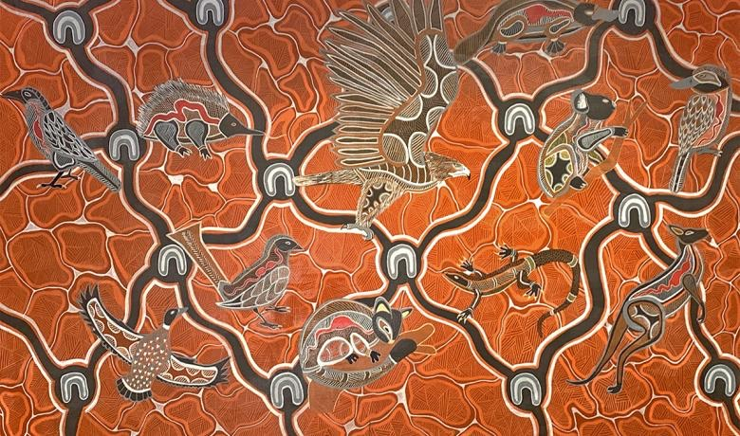
Acknowledgement of Country
Wurundjeri artist:
Ash Firebrace (2021)
Notes:
I acknowledge that I am hosting this meeting from the lands of Dja Dja Wurrung people of the Kulin Nation.
I also acknowledge the Traditional Custodians of the various lands on which you work and live, and the Aboriginal and Torres Strait Islander people participating in this meeting.
I pay my respects to Elders past, present and emerging.

Slide 3

Introductions
Name
Organisation
What I want to get out of today?
Notes:
Who is in the room – meet & greet

Slide 4
Workshop 2
Recap
Seven Top Tips to attract potential volunteers:
  Know Your Mission /Vision
  Systems and Processes
  Meeting the Market
  Inclusivity and Accessibility
  Worthwhile Volunteer Roles
  Integrated Workforce Culture
  Success Stories
Notes:
Let’s recap workshop 2 before moving to today’s presentations.
Know Your Mission- the mission keeps everyone focused on what we are wanting to achieve
Systems and Processes – give us the methodology to reach our goals
Meeting the Market – find the expectations of our community and what they want
Inclusivity and Accessibility – allowing everyone whatever their background, abilities, age etc. to participate in activities that will benefit your organisation and our community.
Worthwhile Volunteer Roles – give meaningful opportunity to the volunteer, builds their sense of achievement and shows they are highly valued
Integrated Workforce Culture – staff and volunteers appreciate each other and work together to achieve goals
Success Stories – record the volunteers stories, what they achieved, how they benefited and how you benefited from the time they spent with you.

Slide 5



WHAT TO CONSIDER WHEN RECRUITING FOR DIVERSITY?
Workshop 3
Overview
WHY RECRUIT FOR DIVERSITY?
HOW TO RECRUIT FOR DIVERSITY?
Notes:
WHAT TO CONSIDER WHEN RECRUITING FOR DIVERSITY?
WHY RECRUIT FOR DIVERSITY?
HOW TO RECRUIT FOR DIVERSITY?

Slide 6


What to consider when recruiting for diversity?
DIVERSITY / INCLUSION
UNCONSCIOUS BIAS
Notes:
Activity:
On a scale of 1 -5, how familiar are you with the volunteer policies, processes and procedures for your organisation?
(0=no confidence in identifying or explaining, 5= can confidently explain them and map specific volunteer management activities to policies, processes and procedures?)

Slide 7
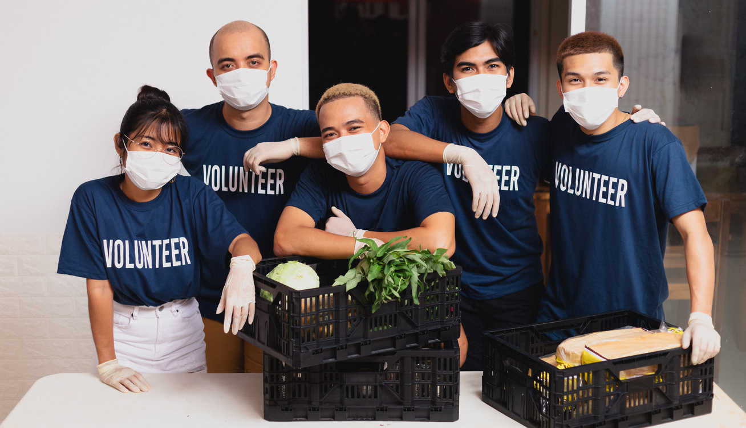
  Do we have a diverse work force?
  Do we have an inclusive work force?
  How safe is my organisation for paid staff and volunteers who belong to minority groups?
Notes:
Lets look at your organisation – how likely is a potential volunteer going to:
See someone who looks like them?
Hear someone who speaks their language
Has a similar background
Shares a religion
Shares knowledge of their foods, cultural activities, music, dance
Find books in their language
Recognise signage i.e. its in their first language
Are your policies and procedures in simple language?
Do you translate documents, flyers and other important materials?
Do you use pictures, sign language or have them available?
Have you asked if the volunteers have needs, preferences. Eng a quiet place for prayer or reflection, heating/cooling for foods, drinks, separate washing, cleaning zones.
Do they have celebratory days that are different to the Australian Public Holidays? Can you be flexible in allowing them to have that day/s to celebrate?

Slide 8
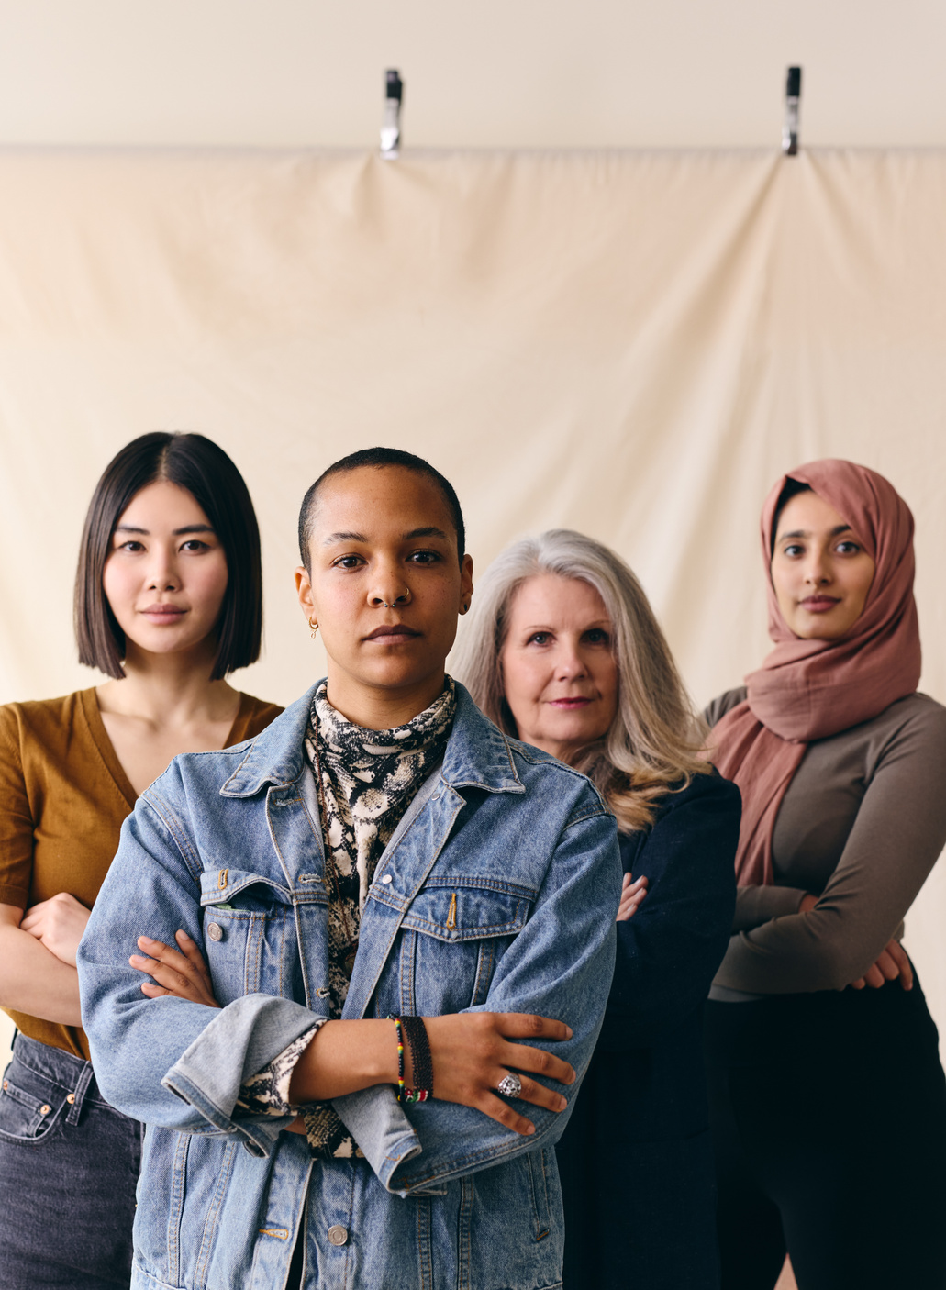
Diversity does not automatically ensure inclusion
First step to inclusion is to be diverse BUT active steps need to be taken in order for diverse identities to be authentically included.
Notes:
Equity v equality
Do you have cultural understanding of your volunteer group?
Have you taken time to sit down with your volunteers and asked them about their culture and what their needs are?
Is every volunteer included in team activities?
Have you had a session with staff to explain about the for inclusivity and what it means for them?
Perhaps your volunteers can talk about their culture at team meetings,, covering music, foods. Religion, dress, education etc that is part of their life.
For example, a team drinks night might sound fun but is it inclusive to all your team?
Is a team lunch a good idea during Ramadan?

Slide 9

Consider
  What unconscious biases/ assumptions do I hold about particular identities and their capabilities?
  How might these beliefs influence the way I/ my organisation recruits volunteers?
  How might these beliefs influence the way I/ my organisation treats diverse volunteers?
Notes:
,
What unconscious biases/ assumptions do I hold about particular identities and their capabilities?
How might these beliefs influence the way I/ my organisation recruits volunteers?
How might these beliefs influence the way I/ my organisation treats diverse volunteers?
Levels of English, level of education, not trained

Slide 10


Why Recruit for Diversity?
REPRESENTATION, INCLUSIVE CAPACITY, UNTAPPED VOLUNTEER POOLS
Notes:
Look at your community,
is there a pool of potential volunteers that you do not utilise?
New migrants, children, parents, grandparents
Bringing them on board increases your knowledge about those who live in your community, how this is changing things e.g. schools growing in numbers, sports teams having to teach newbies how to play, even learning how to pronounce names correctly
School students of all ages – this age group love to volunteer………….. As long as its meaningful and is over quickly. It needs to be short term with outcomes each time they come in.
Think of players for netball, football, cricket and tennis, gymnastics…… music…. Art….. It just goes on and on.
Good at IT !!!!
Share their culture

Slide 11
How will your volunteering program benefit from a more inclusive approach?
Attracting a more diverse group of volunteers
Building a more sustainable volunteer workforce:
Reflecting the community as a whole
in your volunteering program:
Creating an inclusive climate in your organisation
Notes:
1. Attracting a more diverse group of volunteers:
Through engaging volunteers from varying backgrounds and abilities you will attract volunteers who will offer your volunteering program a wide range of skills, experiences and new perspectives.
2. Building a more sustainable volunteer workforce:
Adopting a more inclusive approach is a smart strategy particularly given the impact the aging population is likely to have on volunteer recruitment in the years to come. A broad, inclusive outreach in recruitment may be the difference between a volunteer program flourishing or ceasing.
3. Your volunteer program reflects the community as a whole and makes your organisation more attractive and comfortable for volunteers to consider taking on roles.
4. Creating an inclusive climate in your organisation: will promote equity, enhance organizational effectiveness and capitalise on the talents of your staff.
Feedback received from volunteer involving organisations, in relation to inclusive placements, has indicated inclusion can promote increased skills and satisfaction for those who manage or work alongside inclusive recruits.
Resource:
https://volunteeringqld.org.au/wp-content/uploads/2021/11/VolACT_Lets_Talk_About_Inclusion.pdf

Slide 12
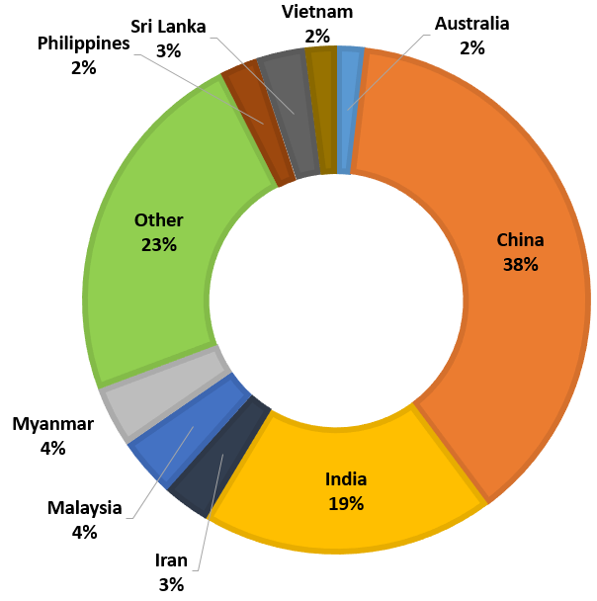
New Migrant population (LMR)
The graph indicates the top 10 countries of birth for new arrivals in the Eastern Metropolitan Region (EMR) in 2017-2018.
A total of 5,328 individuals settled in the EMR between July 2017 and June 2018.
The Migrant Information Centre (Eastern Melbourne) (MIC)
Notes:
Change for Loddon Mallee
This graph shows the diversity of the population within the Eastern Metro region. We are a diverse and vibrant community. How can we utilised these groups? We have a large international student population, are you working with the universities to make the most of this talent? Do you have existing links with some of these communities? Do you know who their faith or community leaders are? What language do these groups use when supporting their community, do they know about formal volunteering or do they operate an informal way of supporting their communities?

Slide 13

Victorian people with disability are diverse in their culture, language, sexuality, gender identity, age, ability, socioeconomic status and life experiences. They are parents, children and young people and live in all parts of the state. Some people's disability is hidden, while other people’s disability is visible. Their experiences and the way they perceive the concept of disability differ.
  VICTORIAN GOVERNMENT, 2022
Notes:
Victorian people with disability are diverse in their culture, language, sexuality, gender identity, age, ability, socioeconomic status and life experiences.
They are parents, children, young, old and in between people who live in all parts of the state.
For some people their disability is hidden, while for others their disability is visible.
Their experiences and the way they perceive the concept of disability differ.

Slide 14

Disability in Victoria
  17% of Victorians are people with disability
  77% of people with disability have a physical disability
  32% of people with disability sometimes or always need support with daily self-care, mobility or communication activities
  24% of Aboriginal people have disability, which is twice the rate of the general population
  39% of LGBTIQA+ people aged 14 to 21 identify as having disability or long-term health condition
Notes:
Just a few figures on disability within Victoria.
You also need to note that a percentage of individuals with an invisible disability (including mental health) will not be counted in statistics as they are hesitant about telling people they have a disability due to previous negative experiences within the workplace.
More research is being done into those individuals that are neuro diverse and LGBTQA+ as there is a strong link to disability within this community.

Slide 15
Number of people with a disability in Victoria is increasing and is expected to continue to grow due to population growth, ageing and increased life expectancy..
-DEPARTMENT OF FAMILIES, FAIRNESS AND HOUSING
Notes:
We also need to take into account the increase in awareness of physical disabilities, mental health and chronic illness within the wider community, education and medical fields.
Also of note is the increase in new migrants arriving into the community who are deaf or those that have come from backgrounds with high levels of trauma.
There is a need for individuals that can teach AUSLAN to migrants whose first language is not English.

Slide 16
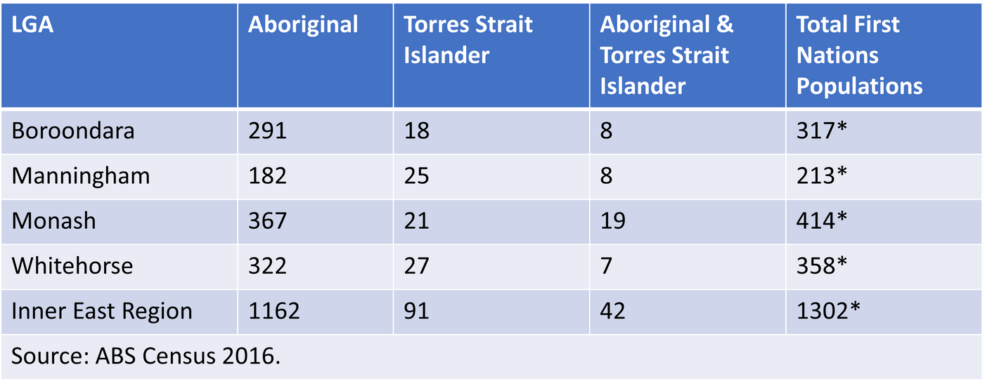
First Nations People
TABLE 1: INNER EAST REGION INDIGENOUS POPULATION
Notes:
*************************** Figures to reflect Loddon Mallee
The number of those identifying as First Nations is increasing as they become more secure in doing so.
The numbers vary across each LGA of the region with the highest numbers in the last census being in the Yarra Ranges.
The need to be Culturally aware is vital. – note any Cultural Awareness training that is running within the region.
Note the challenges with regards to Onboarding – access to ID documentation, concerns regarding police reports.
Note that within the First Nations volunteering is normally informal and not identified as volunteering but as supporting their community.

Slide 17

Representation Matters!
Recruiting a diverse workforce (paid and volunteer) promotes the safe participation of marginalised groups in your community.
You are delivering services to a diverse community.
Your service users have the right to see themselves represented in the services they access.
Notes:
Your service users will feel safe and more comfortable accessing your services if they see individuals like them within the organisation.
By having a diverse workforce your organisation will be acknowledged as an organisation that is open to learning about cultural differences, while welcoming them on board to undertake paid or volunteer roles. This leads to a higher recognition of your organisation within your community.

Slide 18
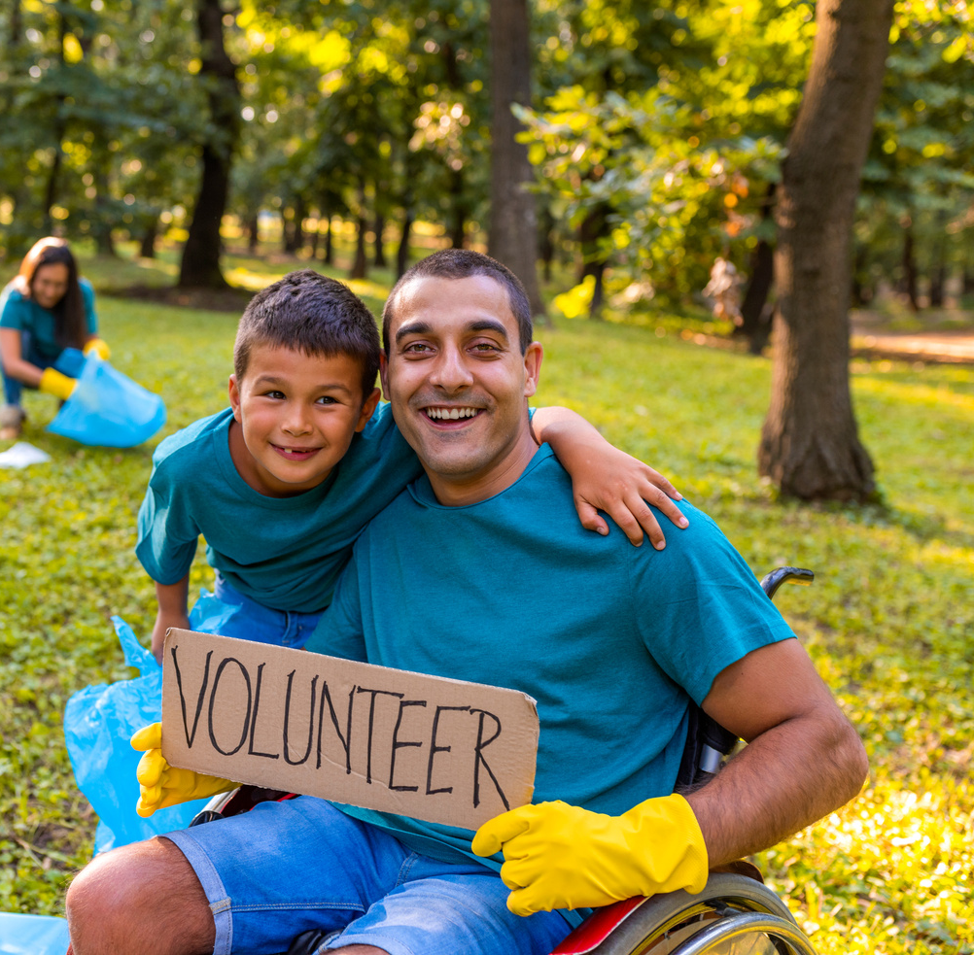
Enhanced Capacity for Inclusive Practice
A diverse pool of volunteers provides a source of knowledge and expertise on the experiences of their communities, enhancing your organisations capacity to deliver inclusive services.
Notes:
By having a diverse workforce you have access to the experts who relate and understand their communities, cultural differences and language. You can utilise this knowledge to improve your service delivery and ensure that access is fair, culturally safe and equitable.

Slide 19


How to Recruit for Diversity?
VOLUNTEER RECRUITMENT POLICY AND PROCESS
Notes:
It is vital that you understand who is in your community.
Are there barriers to them participating in volunteering for you:
Have you considered their needs
Many don’t want to approach your organisation by themselves - Encourage people from diverse backgrounds, to volunteer by offering roles that can be done by two or three people. It’s hard when you come from a different country to have the confidence to be the only one in an organisation. Many would like to volunteer together.
They have young children and need guidance for childcare - Larger organisations may be able to consider childcare, but for smaller ones, consider discussions with other small organisations who are facing the same problem . ….. Could you come up with a solution together? E.g. share a child safe venue where children can be looked after for two or three hours. (Babysitting club??) Negotiation is key for all parties involved. Neighborhood houses, centers, TAFE
Roster volunteers so they can share a car, drop off & pick up children from school, sport or daycare.

Slide 20

Typical Recruitment process
  Recognise the need for a new volunteer
  Create role description
  Seek management approval
  Advertise
  Interview
  Onboard
  Induct
  Train
  ACTIVE placement
HOW CAN I MAKE THIS PROCESS MORE INCLUSIVE?
Notes:
This is the formalized approach that has been the standard for many years.
We need to remember that many of your diverse volunteers will have English as a second language. Many do not have the word volunteer in their language but understand ‘helping out’.
Often all that is required is for you or another of your volunteers to ASK ‘would you like to help me with ……………

Slide 21

Recruiting and On-boarding Volunteers from CALD communities
Notes:
Remember that English is a second language to most migrants. So …….
Keep paperwork to a minimum and keep it simple. Offer to have interpreter available.
Only ask for specific skills if they are needed. E.g. must have drivers license but the role they are doing is administration and they won’t be driving anywhere.
Try to have some diversity on the interviewing panel. Let that person do the welcoming. And if possible, the induction and introductions to your organisation.
Operate with a buddy system so there will always be a known support person for your new volunteers.
Many fear Police Checks, and the like so be very sure they are needed before interviewing.

Slide 22
Recruiting and onboarding Volunteers from culturally/ linguistically diverse communities
  Build relationships with your local CALD communities.
  Network with CALD organisations/ CALD supporting organisations.
  Collaborate with CALD community to develop a CALD volunteering strategy.
  Face to Face communication most effective in building trust.
  CALD representation is your BEST recruitment strategy.
  Advertise in CALD spaces.
  Streamline/ simplify recruitment processes (including background checks).
  Be aware of your use of language.
  Ensure workplace culture is one that embraces and is inclusive of diversity (policies and practices).
  Don’t make assumptions about competencies/ cultural practices.
  Be flexible in your management and support of CALD volunteers.
Notes:
Research your local demographics.
Know who your local CALD community groups are and build relationships with them. Make contact with relevant community leaders.
Create networks with other mainstream community groups e.g. local council, Volunteer Resource Centre, Centrelink multicultural staff, and work together to support culturally diverse volunteers and communities.
Recruit a CALD volunteers or a team of volunteers from different cultural groups to assist development of a CALD volunteering strategy for your organisation.
The most effective way of distributing information into ethnic-specific communities is face-to-face communication. Information presented in this format is often seen as being more trustworthy when a “person” rather than an “institution” delivers it. Work with your local CALD communities to provide information sessions on volunteering and engage CALD volunteers in this process. There is no better ambassador for volunteering than volunteers themselves.
Advertise your volunteer roles and information on volunteering in ethnic community newspapers – these are widely read within the different community groups.
Make it easy for prospective volunteers to get involved. Cut down on the amount of paperwork required to complete, OR, include this as part of your interview process. Too many forms to fill out can be seen as a barrier to volunteering.
The concept of volunteering can be interpreted in many different ways. Think of other ways you can describe (in plain language) what it means to be a volunteer e.g. use phrases such as “help your community”. Ensure your promotional materials reflect this. Enlist LCMS to gain their feedback from a non-English speaking point of view.
Translate complicated policies into plain language to ensure CALD volunteers is understand.
Don't assume that all cultures are the same, especially concerning gender differences. Well-established communities will differ from new and emerging communities in the issues they face, their English proficiency, and their experiences with the wider Australian community.
Flexibility in management: This may include the need to provide extra support to these volunteers such as establishing a mentor or buddy system, an interpreter during the interview and onboarding stages.

Slide 23
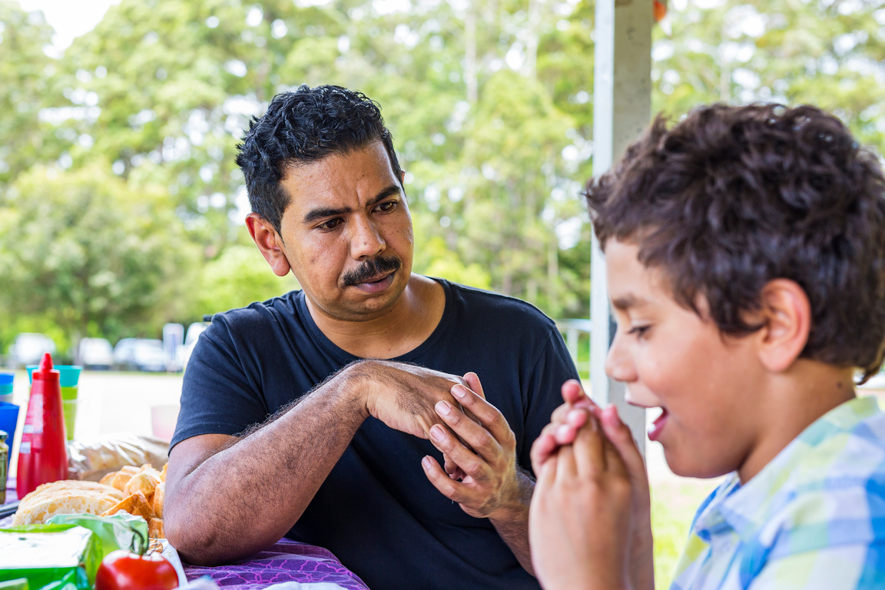
Recruiting and On-boarding First Nations Volunteers
Notes:
Link in to local First Nation advisory groups such as Dja Dja Wurrung (Central Victoria) for guidance about having First Nations volunteers.

Slide 24
Recruiting and on-boarding First Nations Volunteers
Important to recognise that whilst First Nations communities are reported to participate less frequently in formal volunteering they are still actively involved in informal volunteering within their communities.
Notes:
It’s not that First Nations do not volunteer but that different words in their language are used. Volunteering tends to stay within their own communities and to be more informal.
First Nations have very large volunteer investment in Land Care and renewal of land projects across Victoria
Approach through Dja Dja Wurrung Cultural Centre in Eaglehawk. Each region may hold their own training relating to the best way to include First Nations people into your organisation.
Organisations may need to do a benchmarking assessment to determine if they meet cultural requirements.

Slide 25
Recruiting and on-boarding First Nations Volunteers
  Know your First Nations Communities.
  Build trusting relationships.
  Collaborate with First Nations Communities.
  Engage with First Nations volunteer organisation.
  Don't make assumptions about capability of cultural practice.
  Take active steps to engage all staff in cultural safety training specific to the first Nations communities you interact with.
Notes:
Who are your local First Nation Communities?
Dja Dja Wurrung in Bendigo and Central Victoria, Kooyoora in Bridgwater and Loddon.
Introduce yourself and your organisation, see if you can be invited along for a yarn. Let them lead the interactions.
Collaborate, listen and learn
Work on your cultural understanding
Form partnerships and working relationships with First Nation VIOs, work alongside them.
Remember that providing onboarding documentation can be challenging.

Slide 26

Recruiting and On-boarding Volunteers with Disability
Notes:
Whilst we have many people identifying they have a disability, many want to volunteer but have difficulty being placed and are greatly under used.
Consider the word disability. It covers everyone with any kind of infirmity, whether major, minor or in between.
I have a disability.. But I am lucky because my organisation recognises that I am not impaired to do this role.
We must be more broadminded and allow prospective volunteers to describe their abilities and own goals. Can you march them to a role if you adapt a little bit?

Slide 27
Recruiting and on-boarding Volunteers with disability
  Create a Disability Action plan in collaboration with volunteers with lived experience of disability.
  Consider where you can be flexible with role positions.
  Encourage involvement of Support workers-consider training to be provided to both volunteer and support worker.
  Don't make assumptions about abilities.
  Provided varies roles.
  Use a blend of advertising media and consider whether information is accessible via advertising platforms.
Notes:
Best practice as recommended by Volunteering Victoria is to routinely scope volunteer roles and develop Volunteer Role Descriptions. Over time, Role Descriptions can become standardised with unnecessary requirements that create barriers for people with disability. E.g.
Does the volunteer need a drivers license to perform the role?
- Do they need to do heavy lifting?
- Are you able to be flexible with requirements and noted in the role description?
- Can the role be divided or shared by two volunteers?
Do you welcome people with disability, are new to our country or are diverse in other ways?
It is important not to be tokenistic but including a welcoming statement in your role description will lead to a greater pool of talent. Language choice is critical.
Consider promoting your volunteer roles through disability services or disability employment agencies to reach a wider pool of people.
Is your website clear and accessible? Is the font and text readable for assertive technology and software? Is the pathway to volunteer opportunities prominent?
2. Volunteers deserve a valued role and this depends on the expectations and aspirations of the individual. E.g. some people enjoy basic tasks while others prefer lots of changing tasks. Your organisation may require a specific outcome but it may be possible to negotiate details once the volunteers personal preferences have been determined.
3. Using a blend of advertising media is important to ensure that people with a disability can access your volunteer opportunity. Some people with a disability will be dissuaded from applying if they cannot access the recruitment process due to a lack of alternative format, for example, large print, easy English, audio/radio and online.
It is acceptable to specify that positions are suitable for a volunteer with support needs, a disability or with special needs.

Slide 28
Additional Resources for Inclusive Practice
https://volunteeringaustralia.org/wp-content/files_mf/1377052800VAManagersinvolvingvolunteersfromculturallyandlinguisticallydiversebackgrounds.pdf
https://www.volunteeringvictoria.org.au/resources-guides/guides/
https://www.victoriaalive.org.au/resources-2/guides/
https://www.victoriaalive.org.au/wp-content/uploads/2019/09/Disability-Action-Plan1.pdf
https://www.inclusion.melbourne/wp-content/uploads/2012/07/Include-Me-20pp-booklet-colourlow-res.pdf
https://www.volunteeringvictoria.org.au/for-volunteers/indigenous-volunteering/

Slide 29

Time to Discuss and Reflect
Notes:
Note to make,
There is a lot of cross over within these areas.
Very rarely does one volunteer fall under just one of these categories.,
In particular, there is a higher level of mental health documented within all of these communities.
Note –
These communities also have a higher barrier to employment (INCOME) and volunteering comes with costs of both time and money which can make it more difficult for them to participate in volunteering.
Are there any supports you offer to make this easier? E.g. car pool, or fuel card (occasionally), access to lunch.

